Slide 1
Cost-Factor Analysis of Homes in the United States
Agastya Kabir Mahapatra, Idrees Andarr, Mohammad N Hossain

Slide 2
Factors:
Number of Bedrooms
Number of Bathrooms
Living Area (sq. ft)
Location (State)
Home type
Condo
Multiple Family
Single Family
Townhouse
Manufactured

Slide 3
Method of Analysis
In this analysis, we used linear regression to model the relationship between house prices and several key features: the number of bedrooms, bathrooms, and home type (using dummy variables for different home categories). The dataset was preprocessed to remove houses with missing, infinite, or zero price values to ensure data integrity.
The model was trained using the least-squares method, where the coefficients for each feature were estimated by minimizing the difference between the actual house prices and the predicted prices. The model included an intercept term to account for baseline variations in prices.

Slide 4
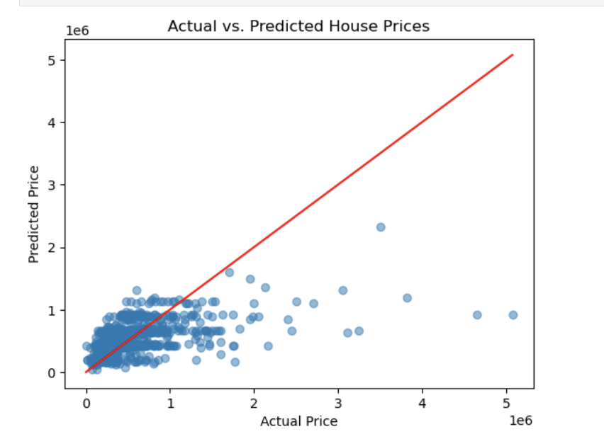
Key Observations:
Most points are clustered in the lower price range, with a general upward trend (as expected, predicted prices increase as actual prices increase).
However, many points deviate from the red "perfect prediction" line, indicating that the model is not perfectly accurate.
There are some cases where the predicted prices are much lower than the actual prices, particularly for higher-priced homes.

Slide 5
Why is the model struggling to predict higher-cost houses?
Our data set originally came with a whooping 118 columns, including a bunch of factors such as rental leads, tax assessed values, and types of property management.
We tried to limit factors to apply our analysis, using ordinary least squares method which requires linear variables (meaning they have a low correlation and are largely independent).
Given these constraints, we limited our data to bedrooms, bathrooms, and hometypes. While we originally tried to include factors such as living area and the year the house was built, these factors showed a heavy correlation (living area with bedrooms and bathrooms, and year built with all three), resulting in huge errors in our calculations.
While these factors are important, they may not capture all the nuances that affect the price of higher-value homes. Features such as location (specific neighborhoods), square footage (living area), recent renovations, amenities, or proximity to services can significantly impact the price, particularly in luxury markets.

Slide 6
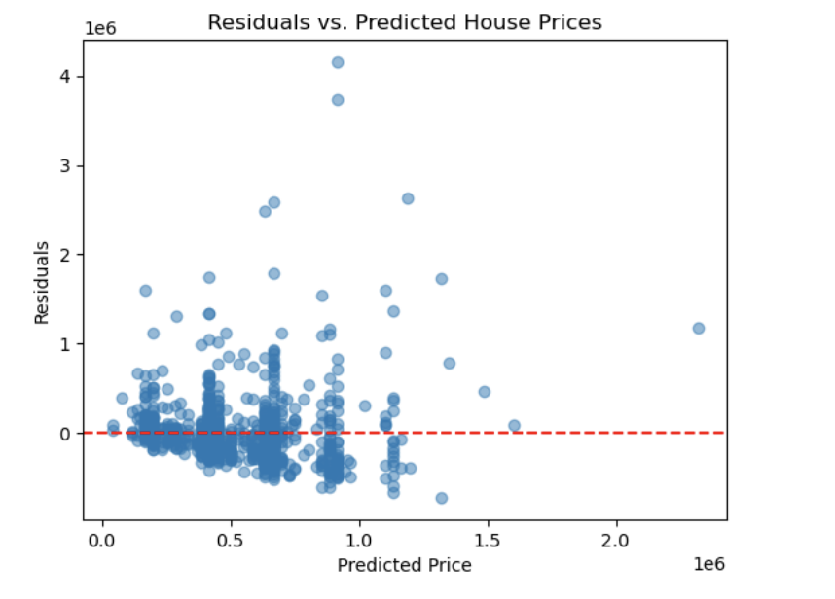
Key Observations:
Residuals seem scattered around zero, indicating that the model has some errors, but there is no clear systematic pattern.
The residuals grow larger for houses with higher predicted prices (the spread increases), indicating that the model struggles more with accurately predicting high-priced homes.
A few large positive residuals suggest that for some high-value homes, the model underestimates the price.

Slide 7
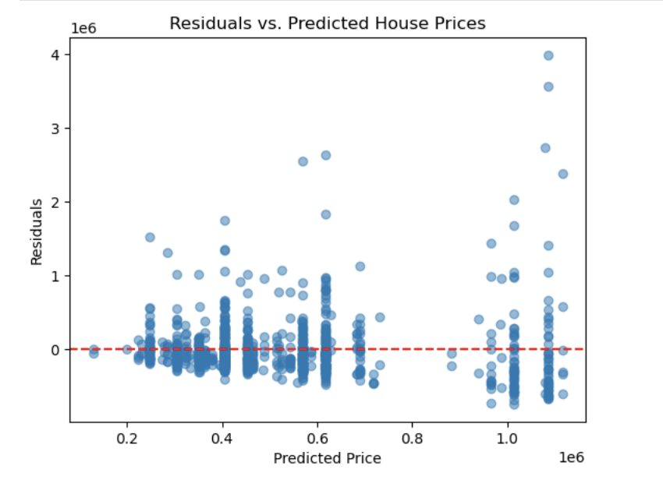
Key Observations
The pattern here is similar to the earlier plot, with residuals generally centered around zero but with some spread, especially for higher predicted prices.
The points for lower predicted prices seem more tightly clustered, indicating the model performs better for predicting lower-priced homes.

Slide 8
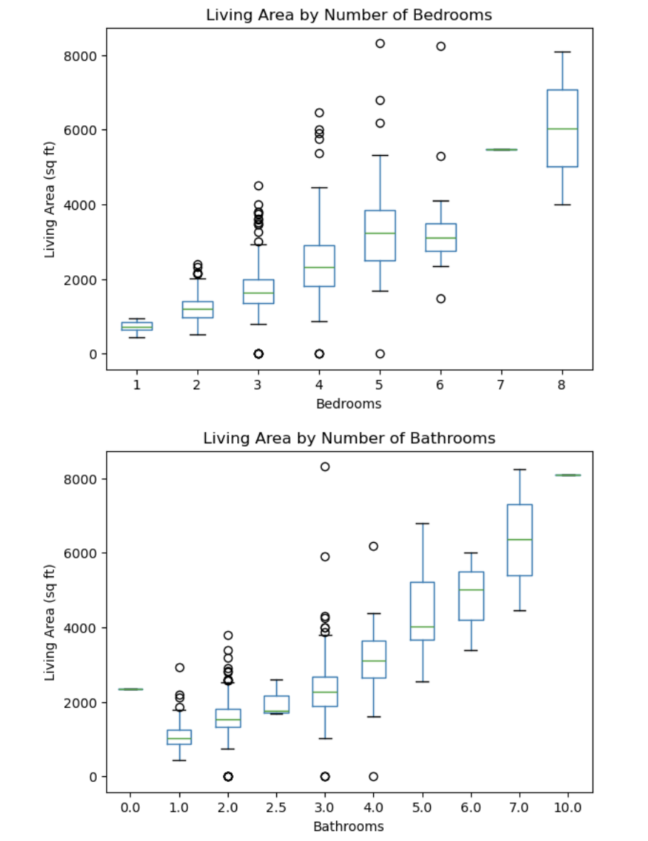
Key Observations:
The median living area increases with the number of bedrooms, which is expected.
3 and 4-bedroom houses are the most common, with a relatively wide range of living areas.
Outliers are present for most categories, especially for houses with 4, 5, and 6 bedrooms, where some homes have significantly larger living areas than the typical house in their category.
As with the bedroom plot, the living area generally increases with the number of bathrooms.
Houses with 3 to 4 bathrooms show a lot of variability, and there are fewer houses with very high bathroom counts (e.g., 7 or more bathrooms).
Outliers are also visible here, particularly for houses with 5 or more bathrooms.

Slide 9
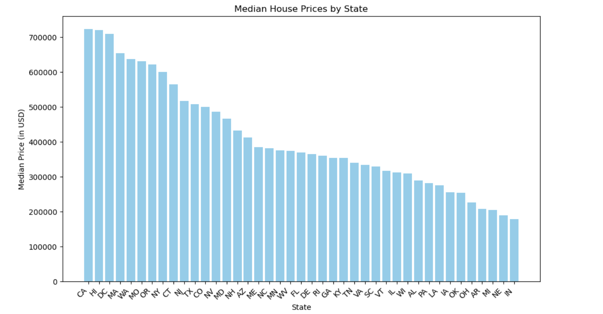
Key Observations:
California (CA), Hawaii (HI), and District of Columbia (DC) appear to have the highest median house prices, above $700,000.
States such as Indiana (IN) and Nebraska (NE) seem to have the lowest median prices, close to or below $150,000.
There's a general decreasing trend in prices as you move right on the x-axis, showing significant variation in house prices depending on the state.

